Slide 1
PYTHON 教學
意諾威機器人程式教育中心

Slide 2
Python 語言特性
直譯式環境，無需compiler
語法簡單
豐富的各種庫
但是 ---------- 執行時比較慢
Python的設計哲學是「優雅」、「明確」、「簡單」

Slide 3
Python 安裝
Python 3 – 未來
Python 2 – 現在(程式庫相容性高)
安裝包 Anaconda – Google search “Anaconda download”
Python的設計哲學是「優雅」、「明確」、「簡單」

Slide 4
Python學習
INTRODUCTION
Getting Started
Keywords & Identifiers
Statements & Comments
Python Datatypes
Python I/O and Import
Python Operators
Python NamespacePython
https://www.programiz.com/python-programming

Slide 5
Python學習
開發環境及基本的輸入輸出 - operator
直譯式環境，可以當科學計算機使用 (operator)
>>> 17 / 3 # int / int -> int
5
>>> 17 / 3.0 # int / float -> float
5.666666666666667
>>> 17 // 3.0 # explicit floor division discards the fractional part
5.0
>>> 17 % 3 # the % operator returns the remainder of the division
2
>>> 5 * 3 + 2 # result * divisor + remainder
17
>>> 5 ** 2 # 5 squared
25
>>> 2 ** 7 # 2 to the power of 7
128

Slide 6
Python學習
變數(number) – int, float, _
>>> 17 / 3 # int / int -> int
5
>>> 17 / 3.0 # int / float -> float
5.666666666666667
>>> 17 // 3.0 # explicit floor division discards the fractional part
5.0
>>> 17 % 3 # the % operator returns the remainder of the division
2
>>> 5 * 3 + 2 # result * divisor + remainder
17
>>> 5 ** 2 # 5 squared
25
>>> 2 ** 7 # 2 to the power of 7
128

Slide 7
Python學習
變數(number) – int, float, _
>>> tax = 12.5 / 100
>>> price = 100.50
>>> price * tax
12.5625
>>> price + _
113.0625
>>> round(_, 2)
113.06

Slide 8
Python學習
變數(string)
>>> 'spam eggs' # single quotes
'spam eggs'
>>> 'doesn\'t' # use \' to escape the single quote...
"doesn't"
>>> "doesn't" # ...or use double quotes instead
"doesn't"
>>> ‘ "Yes," he said.'
‘ "Yes," he said.’
>>> s = 'First line.\nSecond line.' # \n means newline
>>> s # without print, \n is included in the output
'First line.\nSecond line.'
>>> print s # with print, \n produces a new line
First line.
Second line.

Slide 9
Python學習
>>>
Standard Input/output
>>>print(‘Hello World !’)
>>> print("Hello World !, %d years old from 1991"% (26))
>>> print("Hello World !, {0}".format('Steven’))
>>> a_input = input(‘Please input your name :’) #Python2 vs Python3
>>> a_input = raw_input(‘Please input your name :’) #Python2 vs Python3
以下是 print() 方法的語法:
print(*objects, sep=' ', end='\n', file=sys.stdout)
參數
objects -- 表示可以一次輸出多个個對象。需要用 , 分隔。
sep -- 用來隔開多個對象，內定值是空格。
end -- 用來設定以什麼結尾。內定值是換行符 \n，我们可以换成其他字符串。
file -- 要寫入的對象。內定值螢幕

Slide 10
Python學習
>>> word[2:5] # characters from position 2 (included) to 5 (excluded)
'tho'
>>> word[:2] + word[2:]
'Python'
>>> word[:4] + word[4:]
'Python'
>>> word[:2] # character from the beginning to position 2 (excluded)
'Py'
>>> word[4:] # characters from position 4 (included) to the end
'on'
>>> word[-2:] # characters from the second-last (included) to the end
'on'
變數(string)
>>> 3 * 'un' + 'ium'
'unununium’
>>> 'Py' 'thon'
'Python’
>>> prefix + 'thon'
'Python’
>>> word = 'Python'
>>> word[0] # character in position 0
'P'
>>> word[5] # character in position 5
'n'
>>> word[-1] # last character
'n'
>>> word[-2] # second-last character
'o'
>>> word[-6]
'P'
>>> word[0:2] # characters from position 0 (included) to 2 (excluded)
'Py'
+---+---+---+---+---+---+
| P | y | t | h | o | n |
+---+---+---+---+---+---+
0 1 2 3 4 5 6
-6 -5 -4 -3 -2 -1

Slide 11
Python學習
變數(list/array)
序号:方法
1: list.append(obj) 在列表末尾添加新的对象
2: list.count(obj) 统计某个元素在列表中出现的次数
3: list.extend(seq) 在列表末尾一次性追加另一个序列中的多个值（用新列表扩展原来的列表）
4: list.index(obj) 从列表中找出某个值第一个匹配项的索引位置
5: list.insert(index, obj) 将对象插入列表
6: list.pop([index=-1]) 移除列表中的一个元素（默认最后一个元素），并且返回该元素的值
7: list.remove(obj) 移除列表中某个值的第一个匹配项
8: list.reverse() 反向列表中元素
9:list.sort(cmp=None, key=None, reverse=False) 对原列表进行排序

Slide 12
Python學習
Programming (coding)
FLOW CONTROL
Python if...else
Python for Loop
while Loop
break and continue
Pass Statement
Looping Technique

Slide 13
1st program
Python學習
# -*- coding: utf-8 -*-
"""
this program is for practicing string type operator.
To use input() function and +
"""
a = 'Please input your name : '
name = input(a)
hel = "Hi ! "+ name*3 +", wellcom to learn Python."
print(hel)
a = "How old are you ?"
age = input(a)
a = 'Are you male or femail ? '
sex = input(a)
print()
print('these are your information : ' )
print(name + ' is ' + age + ' years old.\n' + 'you are ' + sex +'.\n')

Slide 14
1st program
Python學習
N = 128
ff = list([0]*N)
ff[0] = 1
ff[1] = 1
for i in range(2,N):
ff[i] = ff[i-1] +ff[i-2]
sum=0
for i in range(N):
if (ff[i]%2 == 0) :
# sum += ff[i] # sum = sum + ff[i]
print(i+1,"th value :",ff[i], "sum = ", sum)

Slide 15
1st program
Python學習
s='Please input value of x,y and will print +-*/%//** operators. '
print(s) ➔(a是字串形態 str )
sx=input(‘x =‘) ➔(sx也是字串形態 str , 使用input())
sy=input('y =‘) ➔(sy也是字串形態 str , 使用input())
x=int(sx) ➔(x是數字形態 int , 使用int(),float()轉換字串為數字, str()轉換數字為字串)
y=int(sy)
z=x+y ➔(z是數字形態, type(z) check ? )
print(x,'+', y, '=', z)
z=x-y
print(x,'-', y, '=', z)
z=x*y
print(x,'*', y, '=', z)
z=x/y
print(x,'/', y, '=', z)
z=x//y
print(x,'//', y, '=', z)
z=x%y
print(x,'%', y, '=', z)
z=x**y
print(x,'**', y, '=', z)

Slide 16
1st program
Python學習
# 計算 0 – 99 加總
j=0
for i in range(100):
j+=i
print(i,'\t',j)
練習
# 9 x 9 乘法表程式

Slide 17
Python學習
# Program for loop practice_1
j=0
for i in range(100):
j+=i
print(i,'\t’,j)
#列出0到99的連加結果
# Program for loop practice_2
for i in range(1,10):
for j in range(1,10):
print(i*j,end='\t ')
print()
#輸出什麼呢 ？

Slide 18
# 猜數字遊戲
'''
Design a game for guess number
'''
import random
# from random import *
ans = random.randint(0,100)
# ans = randint(0,100)
guess_result = False
guess_times = 0
guess_num = 0
min_num = 0
max_num = 99
while guess_result == False:
if guess_num == ans:
show_str = 'Congraguration ! You are Right. The number is ' + str(guess_num)
print(show_str)
show_str = 'You total spent ' + str(guess_times) + ' times'
print(show_str)
guess_result = True
else :
guess_times += 1
if guess_num > ans:
show_str = 'Please key in number between ' + str(min_num) + ' - ' + str(guess_num) +' : '
max_num = guess_num
else:
# This condition should be guess_num < ans
show_str = 'Please key in number between ' + str(guess_num) + ' - ' + str(max_num) +' : '
min_num = guess_num
guess_num = int(input(show_str))
Python學習

Slide 19
Python學習
矩陣(Lists)
>>> squares = [1, 4, 9, 16, 25]
>>> squares
[1, 4, 9, 16, 25]
>>> squares[0] # indexing returns the item
1
>>> squares[-1]
25
>>> squares[-3:] # slicing returns a new list
[9, 16, 25]
>>> squares[:]
[1, 4, 9, 16, 25]
>>> squares + [36, 49, 64, 81, 100]
[1, 4, 9, 16, 25, 36, 49, 64, 81, 100]
>>> squares[5] = 38
>>> squares
[1, 4, 9, 16, 25, 38, 49, 64, 81, 100]
>>> cubes.append(216) # add the cube of 6
>>> cubes.append(7 ** 3) # and the cube of 7
>>> cubes
[1, 8, 27, 64, 125, 216, 343]

Slide 20
Python學習
矩陣(Lists)
>>> letters = ['a', 'b', 'c', 'd', 'e', 'f', 'g']
>>> letters
['a', 'b', 'c', 'd', 'e', 'f', 'g']
>>> # replace some values
>>> letters[2:5] = ['C', 'D', 'E']
>>> letters
['a', 'b', 'C', 'D', 'E', 'f', 'g']
>>> # now remove them
>>> letters[2:5] = []
>>> letters
['a', 'b', 'f', 'g']
>>> # clear the list by replacing all the elements with an empty list
>>> letters[:] = []
>>> letters
[]
>>> letters = ['a', 'b', 'c', 'd']
>>> len(letters)
4
>>> a = ['a', 'b', 'c']
>>> n = [1, 2, 3]
>>> x = [a, n]
>>> x
[['a', 'b', 'c'], [1, 2, 3]]
>>> x[0]
['a', 'b', 'c']
>>> x[0][1]
'b'

Slide 21
Python學習
Programming (coding)
>>> # Fibonacci series:
... # the sum of two elements defines the next
... a, b = 0, 1
>>> while b < 10:
... print b
... a, b = b, a+b
...
1
1
2
3
5
8
>>> a, b = 0, 1
>>> while b < 1000:
... print b,
... a, b = b, a+b
...
1 1 2 3 5 8 13 21 34 55 89 144 233 377 610 987
!! 空格內縮當程式的區段

Slide 22
Python學習
Programming (coding) – if
>>> x = int(raw_input("Please enter an integer: "))
Please enter an integer: 42
>>> if x < 0:
... x = 0
... print 'Negative changed to zero'
... elif x == 0:
... print 'Zero'
... elif x == 1:
... print 'Single'
... else:
... print 'More'
...
More

Slide 23
Python學習
Programming (coding) – for loop
>>> for w in words[:]: # Loop over a slice copy of the entire list.
... if len(w) > 6:
... words.insert(0, w)
...
>>> words
['defenestrate', 'cat', 'window', 'defenestrate’]
>>> a = ['Mary', 'had', 'a', 'little', 'lamb']
>>> for i in range(len(a)):
... print i, a[i]
...
0 Mary
1 had
2 a
3 little
4 lamb

Slide 24
Python學習
Programming (coding) – break /continue
>>> for n in range(2, 10):
... for x in range(2, n):
... if n % x == 0:
... print n, 'equals', x, '*', n/x
... break
... else:
... # loop fell through without finding a factor
... print n, 'is a prime number'
...
2 is a prime number
3 is a prime number
4 equals 2 * 2
5 is a prime number
6 equals 2 * 3
7 is a prime number
8 equals 2 * 4
9 equals 3 * 3
>>> for num in range(2, 10):
... if num % 2 == 0:
... print "Found an even number", num
... continue
... print "Found a number", num
Found an even number 2
Found a number 3
Found an even number 4
Found a number 5
Found an even number 6
Found a number 7
Found an even number 8
Found a number 9

Slide 25
Python學習
Programming (coding) – function
>>> def greet():
#This function greets to
#the person passed in as
#parameter
name = “Steven”
print("Hello, " + name + ". Good morning!")
greet()
>>> def greet(name):
# This function greets to
# the person passed in as
# parameter
print("Hello, " + name + ". Good morning!")
greet("Steven")

Slide 26
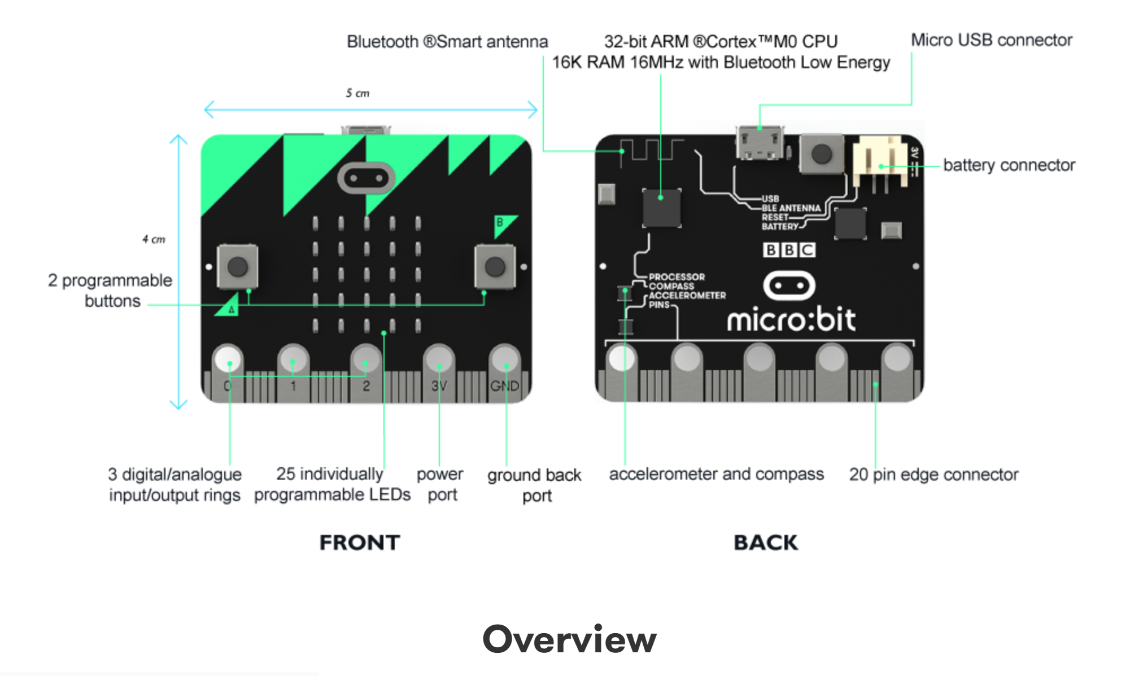
認識硬體 Microbit

Slide 27
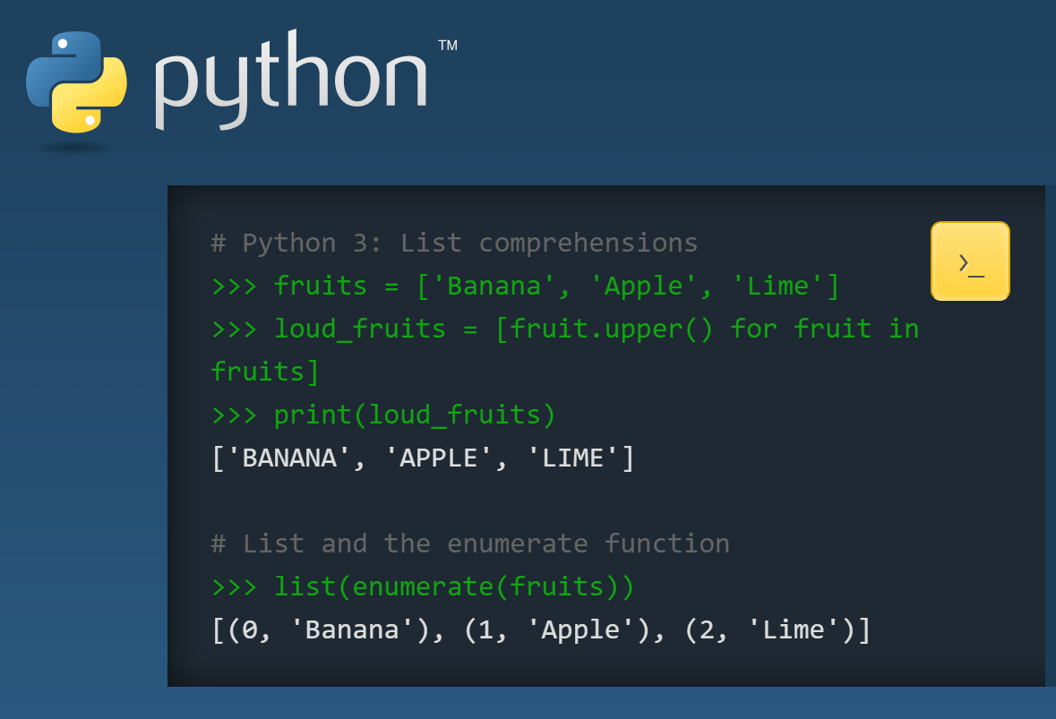
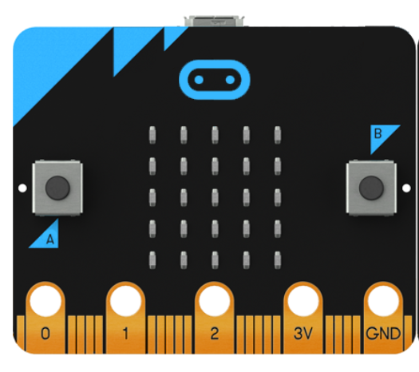
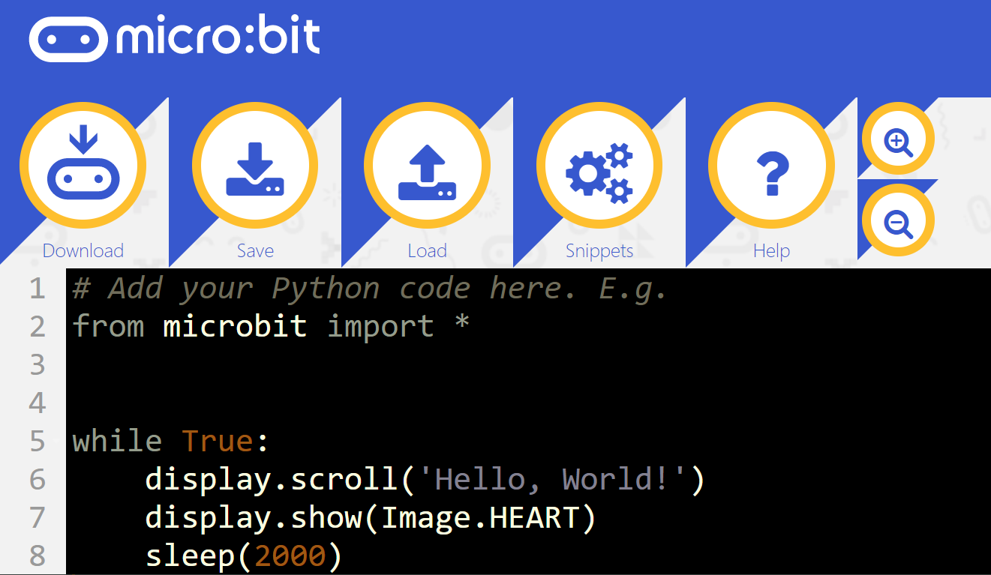

Slide 28
認識硬體 Microbit
25 LED (5 x 5)
2 可程式按鈕
GPIO pin (I/O pin)
光線和溫度感測器
動態感測器 – 加速度感測器及電子羅盤
2.4G無線及藍牙連線功能
USB 介面
http://microbit-micropython.readthedocs.io/en/latest/display.html

Slide 29
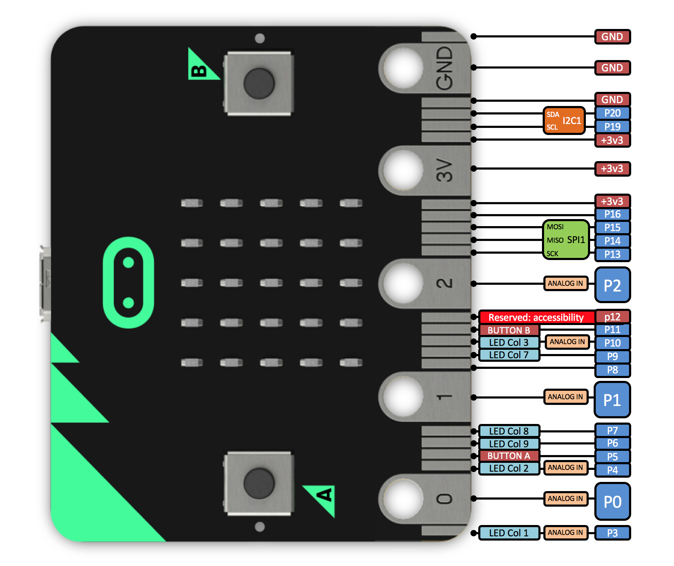
認識硬體 Microbit

Slide 30
Python學習
Micro:bit API function
# sleep for the given number of milliseconds.
sleep(ms)
# returns the number of milliseconds since the micro:bit was last switched on.
running_time()
# makes the micro:bit enter panic mode (this usually happens when the DAL runs
# out of memory, and causes a sad face to be drawn on the display). The error
# code can be any arbitrary integer value.
panic(error_code)
# resets the micro:bit.
reset()

Slide 31
Python學習
Micro:bit API function
Button :
button_a
button_b
Object function:
# returns True or False to indicate if the button is pressed at the time of
# the method call.
button.is_pressed()
# returns True or False to indicate if the button was pressed since the device
# started or the last time this method was called.
button.was_pressed()
# returns the running total of button presses, and resets this counter to zero
button.get_presses()

Slide 32
Python學習
Micro:bit API function
LED :
# gets the brightness of the pixel (x,y). Brightness can be from 0 (the pixel
# is off) to 9 (the pixel is at maximum brightness).
display.get_pixel(x, y)
# sets the brightness of the pixel (x,y) to val (between 0 [off] and 9 [max
# brightness], inclusive).
display.set_pixel(x, y, val)
# clears the display.
display.clear()
# shows the image.
display.show(image, delay=0, wait=True, loop=False, clear=False)
# shows each image or letter in the iterable, with delay ms. in between each.
display.show(iterable, delay=400, wait=True, loop=False, clear=False)
# scrolls a string across the display (more exciting than display.show for
# written messages).
display.scroll(string, delay=400)

Slide 33
Python學習
Micro:bit API function
LED :
# sets the pixel at the specified position (between 0 and 9). May fail for
# constant images.
image.set_pixel(x, y, value)
# gets the pixel at the specified position (between 0 and 9)
image.get_pixel(x, y)
# returns a new image created by shifting the picture left 'n' times.
image.shift_left(n)
# returns a new image created by shifting the picture right 'n' times.
image.shift_right(n)
# returns a new image created by shifting the picture up 'n' times.
image.shift_up(n)
# returns a new image created by shifting the picture down 'n' times.
image.shift_down(n)

Slide 34
Python學習
Micro:bit API function
LED Ex.:
boat = Image("05050:"
"05050:"
"05050:"
"99999:"
"09990")
display.show(boat)
LED Ex.:
display.show(Image.HAPPY)

Slide 35
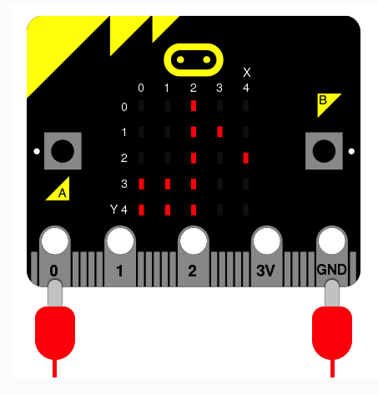
Python學習
Micro:bit API function
Import music
Music.play(music.PRELUDE)
music.DADADADUM music.ENTERTAINER
music.PRELUDE music.ODE
music.NYAN music.RINGTONE
music.FUNK music.BLUES
music.BIRTHDAY music.WEDDING
music.FUNERAL music.PUNCHLINE
music.PYTHON music.BADDY
music.CHASE music.BA_DING
music.WAWAWAWAA music.JUMP_UP
music.JUMP_DOWN music.POWER_UP
music.POWER_DOWN

Slide 36
Python學習
Micro:bit API function
Import music
tune = ["C4:4", "D", "E", "C", "C", "D", "E", "C", "E", "F", "G:8",
"E:4", "F", "G:8"]
music.play(tune)
for freq in range(880, 1760, 16):
music.pitch(freq, 6)
for freq in range(1760, 880, -16):
music.pitch(freq, 6)

Slide 37
Python學習
Micro:bit API function
PIN :
Pin0, pin1,……pin16, pin19, pin20
PIN :
# value can be 0, 1, False, True
pin.write_digital(value)
# returns either 1 or 0
pin.read_digital()
# value is between 0 and 1023
pin.write_analog(value)
# returns an integer between 0 and 1023
pin.read_analog()
# sets the period of the PWM output of the pin in milliseconds
# (see https://en.wikipedia.org/wiki/Pulse-width_modulation)
pin.set_analog_period(int)
# sets the period of the PWM output of the pin in microseconds
# (see https://en.wikipedia.org/wiki/Pulse-width_modulation)
pin.set_analog_period_microseconds(int)
# returns boolean
pin.is_touched()

Slide 38
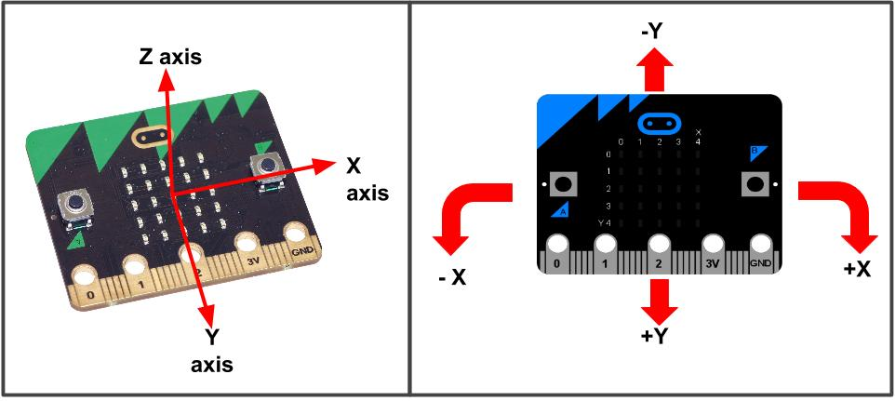
Python學習
accelerometer.get_x()
accelerometer.get_y()
accelerometer.get_z()
# get tuple of all three X, Y and Z readings (listed in that order).
accelerometer.get_values()
# return the name of the current gesture.
accelerometer.current_gesture()
# return True or False to indicate if the named gesture is currently active.
accelerometer.is_gesture(name)
accelerometer.was_gesture(name)
# return a tuple of the gesture history. The most recent is listed last.
accelerometer.get_gestures()
Micro:bit API function
Accelerometer(加速度感測器，陀螺儀)
gestures are: up, down, left, right, face up, face down, freefall, 3g, 6g, 8g, shake.

Slide 39
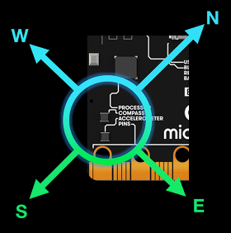
Python學習
Micro:bit API function
# calibrate the compass (this is needed to get accurate readings).
compass.calibrate()
# return a numeric indication of degrees offset from "north".
compass.heading()
# return an numeric indication of the strength of magnetic field around
# the micro:bit.
compass.get_field_strength()
# returns True or False to indicate if the compass is calibrated.
compass.is_calibrated()
# resets the compass to a pre-calibration state.
compass.clear_calibration()
Compass(磁力計、方位儀)

Slide 40
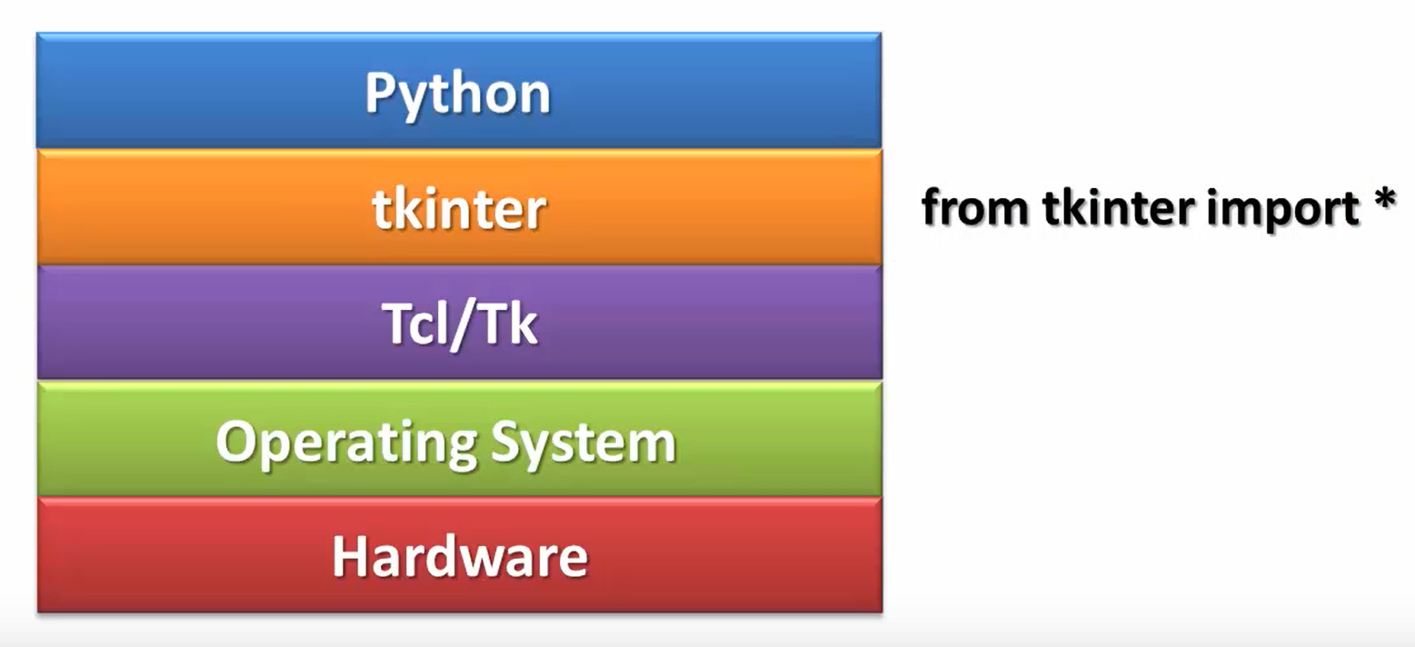
視窗介面設計 - tkinter
Tkinter 是使用 python 進行視窗視窗設計的模組. 簡單的構造, 多平臺, 多系統的相容性, 能讓它成為讓你快速基本的視窗介面好幫手. 它在 python 視窗視窗模組中是一款簡單，用來入門, 熟悉 視窗的人機介面使用.
Import tkinter as tk

Slide 41
Python學習 – tkinter應用
tkinter 為 Python 內建的 GUI 程式庫 (library) ，基本使用順序如下
建立 Tk 物件， Tk 物件是視窗應用程式。
Tk 物件呼叫 mainloop() 方法，維持視窗在螢幕上顯示。
Import tkinter as tk
window_a = tk.Tk()
Window_a.mainloop()
https://tkdocs.com/index.html
https://infohost.nmt.edu/tcc/help/pubs/tkinter/web/index.html

Slide 42
Python學習 – tkinter應用
from tkinter import tk
window_a = tk.Tk()
window_a.title('I am test’)
window_a.configure(width=500, height=500, bg=‘#550000’)
#window_a. geometry('500x500+250+250’)
#window_a.configure(background=‘#550000’)
window_a.resizable(width=False, height=False)
window_a. mainloop()
window_a.winfo_screenwidth() #get screen width
window_a. winfo_screenheight() #get screen height
window_a. geometry(‘%dx%d+%d+%d’ % (500, 500, 250, 250))
https://tkdocs.com/index.html
https://infohost.nmt.edu/tcc/help/pubs/tkinter/web/index.html

Slide 43
Python學習 – tkinter應用
tkinter 有以下的視窗元件
Button 按鈕。 Canvas 長方形區域。
Checkbutton 核取按鈕。 Entry 文字輸入欄。
Frame 視窗。 Label 文字標籤。
LabelFrame 文字標籤視窗。 Listbox 列表選單。
Menu 選單列的下拉式選單。 MenuButton 選單的選項。
Message 類似 Label ，可多行。 OptionMenu 下拉式的選項選單。
PaneWindow 類似 Frame ，可包含其他視窗元件。
Radiobutton 單選按鈕。 Scale 拉桿。
Scrollbar 捲軸。 Spinbox 微調器
Text 文字方塊。 Toplevel 新增視窗。

Slide 44
Python學習 – tkinter應用
Label 標籤
mlabel = Label(window_a, text = ‘Demo window 1’)
mlabel.pack()
mlabel2 = Label(window_a, text=‘color test !', fg="blue")
mlabel2.pack()
mlabel3 = Label(window_a, text=‘background test !', fg="blue”, bg=“yellow”)
mlabel3.pack()
mlabel4 = Label(window_a, text='this is a test !', fg="blue", bg='yellow', font='Arial 32')
mlabel4.pack()
mlabel4 = Label(window_a, text='this is a test !', fg="blue", bg='yellow', font='Arial 32 bold underline')
mlabel4.pack()
mlabel4 = Label(window_a, text='this is a test !', fg="blue", bg=‘#00aaaa', font='Arial 32’, width=16, height=2)
mlabel4.pack()
mlabel4 = Label(window_a, text='this is a test !', fg="blue", bg=‘#00aaaa', font='Arial 32’, width=16,
bd=8, relief=‘groove’) #bd:borderwidth relief:[flat, raised, sunken, ridge, solid, groove]
mlabel4.pack()

Slide 45
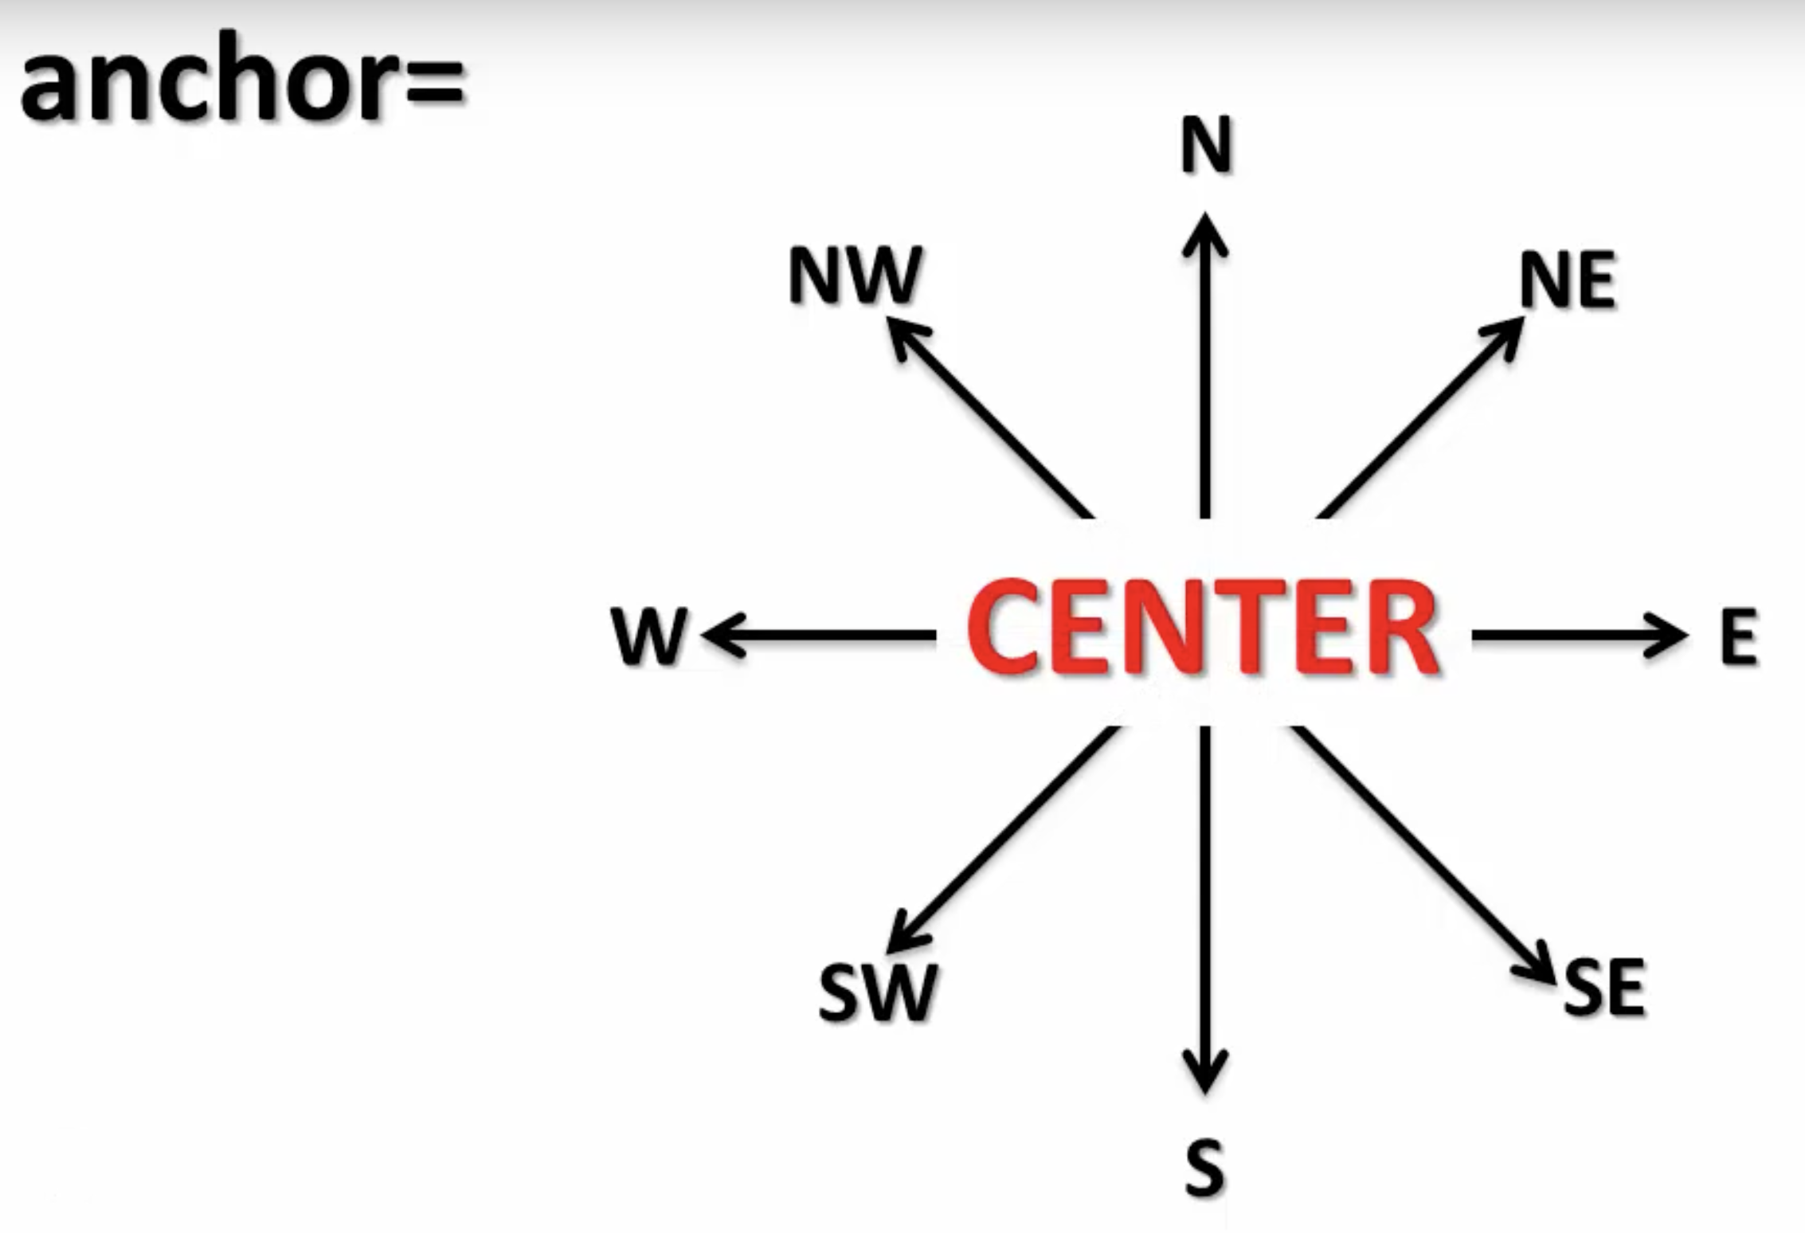
Python學習 – tkinter應用
mlabel = Label(window_a, text=‘My name is Steven.\nI am a teacher.’,
fg="blue",
bg=‘#00aaaa’,
font='Arial 32’,
width=40,
height=8,
bd=8,
relief=‘groove’,
anchor= ‘se’ )
mlabel.pack()
#other attributes
padx=10,
pady=20,
justify=CENTER. #LEFT, RIGHT
#get attributes
mlabel[‘fg’]
mlabel[‘anchor’]
print(mlabel.keys())

Slide 46
Python學習 – tkinter應用
Button 按鈕
#new additional attributes
command = excute_function
cursor = #mouse type on button
from tkinter import *
def ch_Color():
mylab['text'] = 'change color to green'
mylab['fg'] = 'green'
def msgname():
mylab['text'] = 'What\'s your name ?’
mywin = Tk()
mywin.title('GUI button design')
mylab = Label(mywin, relief='sunken',
font='Arial 16',
padx =5, pady=5,
width = 20, height = 2)
but_1 = Button(mywin, text='Question ?', command=msgname)
but_2 = Button(mywin, text='Change color', command=ch_Color)
mylab.pack()
but_1.pack()
but_2.pack()
mywin.mainloop()

Slide 47
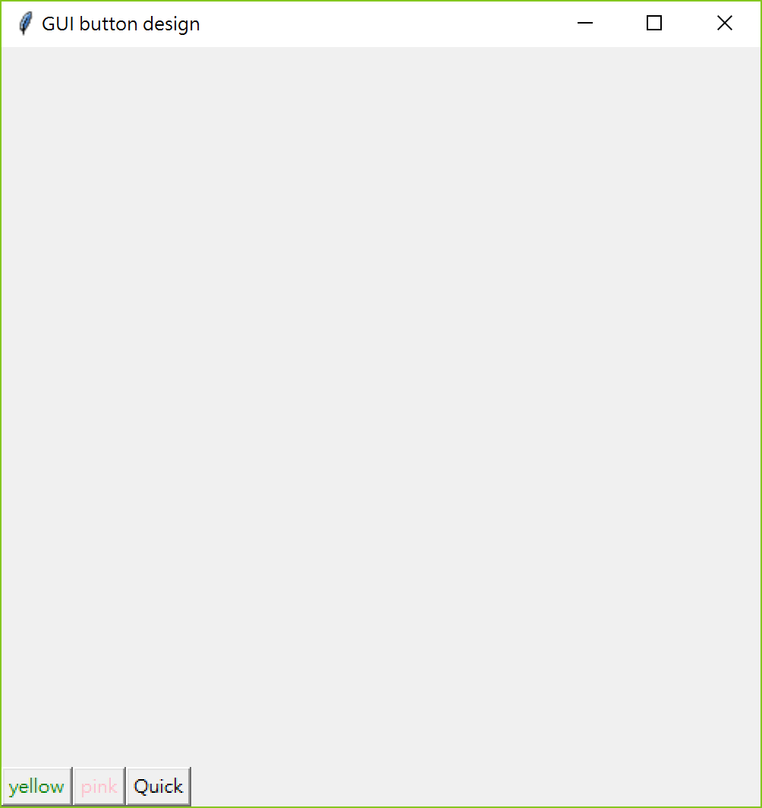
Python學習 – tkinter應用
from tkinter import *
def ch_background(swin, scolor):
swin.configure(bg=scolor)
mywin = Tk()
mywin.title('GUI button design')
mywin.geometry('500x500')
mylab = Label(mywin)
but_1 = Button(mywin, text='yellow', fg='green', command=lambda:ch_background(mywin, "yellow"))
but_2 = Button(mywin, text='pink', fg='pink', command=lambda:ch_background(mywin, "pink"))
but_3 = Button(mywin, text='Quick', command=mywin.destroy)
but_1.pack(anchor='se', side = LEFT)
but_2.pack(anchor='se', side = LEFT)
but_3.pack(anchor='se', side = LEFT)
mywin.mainloop()

Slide 48
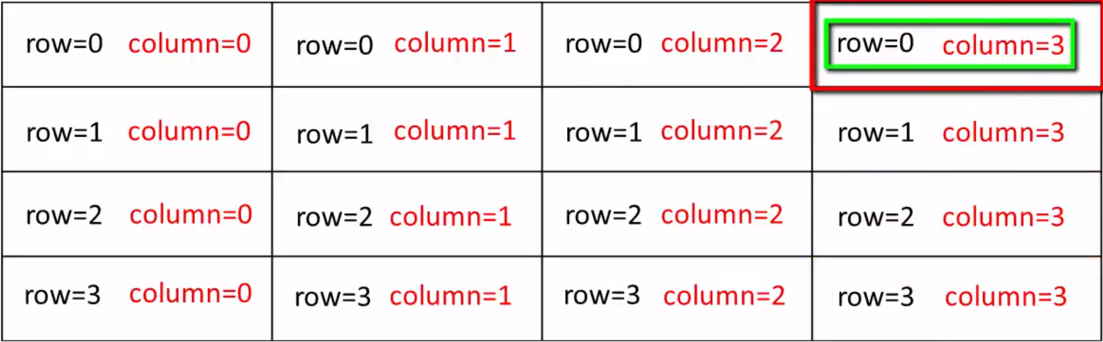
Python學習 – tkinter應用
from tkinter import *
mywin = Tk()
mywin.title('GUI design class’)
mylb_1 = Label(mywin, text="label 1 green", font='Arial 12',
bg = 'green', fg = "#ff0000",
padx = 5, pady = 5)
mylb_2 = Label(mywin, text="blue label 2", font='Arial 12',
bg = 'blue', fg = "#eeeeee",
padx = 5, pady = 5)
mylb_3 = Label(mywin, text="brown label 3", font='Arial 12',
bg = 'brown', fg = "yellow",
padx = 5, pady = 5)
mylb_1.grid(row = 0, column = 0)
mylb_2.grid(row = 1, column = 1, padx = 10)
mylb_3.grid(row = 2, column = 2)
mywin.mainloop()
#other attributes
rowspan = 2 #佔2 row
columnspan = 2 #佔2行

Slide 49
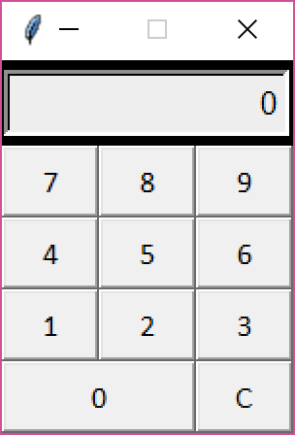
Python學習 – tkinter應用

Slide 50
Python學習
Entry
#attributes
myEntry = Entry(mywin)
myPWD = Entry(mywin, show=“*”)
myEntry.get()
myEntry.insert(0, “Steven”) #insert(index, string)
myEntry.delete(0, END) #delete(first, last) delete char from first to last-1
Variable class of tkinter
X = IntVar()
X = DoubleVar()
X = StringVar()
X = BooleanVar()
X.get()
X.set()
X.trace('w’, function_name) #When X change, trigger function_name to execute
Mylab = Label(mywin, textvariable = X)

Slide 51
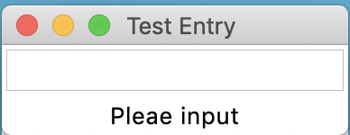
Python學習
from tkinter import *
def callback(*args):
SV_label.set(SV_entry.get())
my_win = Tk()
my_win.title("Test Entry")
SV_label = StringVar()
my_label = Label(my_win, textvariable=SV_label)
SV_entry = StringVar()
my_entry = Entry(my_win, textvariable=SV_entry, show="*")
SV_label.set("Pleae input")
SV_entry.trace('w', callback)
my_entry.grid(row=0, column=0)
my_label.grid(row=1, column=0)
my_win.mainloop()

Slide 52
Python學習
Design a app for unit conversion. ( lb = 0.454kg = 16oz )

Slide 53
Python學習
Radiobutton #only one can be selection
#attributes
def printselect():
a = Var_select.get()
if a == 1:
print(“ 你是男生”)
elif a == 2:
print(“ 你是女生”)
Var_select = IntVar()
Var_select.set(1)
Radio_1 = Radiobutton(mywin, text=“Male”,
variable = Var_select, value = 1,
command = printselect)
Radio_2 = Radiobutton(mywin, text=“Female”,
variable = Var_select, value = 2,
command = printselect)

Slide 54
Python學習
Checkbutton # can be multi-selection
#attributes
Var_select_1 = IntVar()
Var_select_2 = IntVar()
Check_1 = Checkbutton(mywin, text=“Male”,
variable = Var_select_1) #Var_select_1 return 1 or 0
Check_2 = Checkbutton(mywin, text=“Female”,
variable = Var_select_2) #Var_select_2 return 1 or 0

Slide 55
Python學習
from tkinter import *
aa=''
def exit_command():
global aa
aa = var_1.get() + "0"
print(aa)
mywin_1.destroy()
var_1 = StringVar()
mywin_1 = Tk()
mywin_1.configure(bg='yellow')
Label(mywin_1, textvariable=var_1).pack()
var_1.set('Window No. 1')
Button(mywin_1, text='exit', command=exit_command).pack()
mywin_1.mainloop()
mywin_2 = Tk()
var_2 = StringVar()
mywin_2.configure(bg='red')
Label(mywin_2, textvariable=var_2).grid()
Button(mywin_2, text='Exit', command=mywin_2.destroy).grid(row=1)
var_2.set(aa)
mywin_2.mainloop()
Get focus
Object.focus()
按TAB會依宣告的順序得到focus ? 還是pack/grid的順序得到 focus ?
『關閉視窗』
mywin.destroy()
Ex: exit_bu = Button(mywin, text=‘Exit’, command = mywin.destroy)
『離開視窗不關閉程式』
mywin.quit()
雙重視窗 ➔➔➔Ex.

Slide 56
Python學習
Frame – 物件
LabelFrame – 物件
Mywin = Tk()
myFr = Frame(Mywin, width = 480, height = 360)
myLfr = LabelFrame(Mywin, text=‘Message’, width = 200, height = 100)
myFr.pack()
myLfr.pack()
Button(myFr, text=‘del Label’, command=myLfr.pack_forget) #grid_forget

Slide 57
Python學習
Canvas – 畫板
.create_line(x1, y1, x2, y2, ….., fill=‘blue’, width=1, arrow=FIRST, arrowshape=(8,10,3))
.create_rectangle(x1, y1, x2, y2, outline=‘red’, fill=‘blue)
.create_arc(x1, y1, x2, y2, extent=270, outline=‘red’, fill=‘blue) #extent 1 ~ 359
.create_oval(x1, y1, x2, y2, outline=‘red’, fill=‘blue)
.create_polygon(x1, y1, x2, y2, x3, y3, … xn, yn, outline=‘red’, fill=‘blue)
.create_text(x, y, text=‘Ha Ha Ha ..’, anchor=‘w’, font=(‘Arial’, 20), fill=‘blue, justify=LEFT)
mywin=Tk()
myCan=Canvas(mywin, width=480, height=360, bg=‘yellow’)
myCan.create_line(…..
myCan.pack()

Slide 58
Python學習 – pyinstaller : 將python convert to EXE
安裝:
Conda install –c conda-forge pyinstaller
Conda install –c anaconda pywin32
Compile:
Pyinstaller –F –w xxx.py (轉換成一個執行檔並不開啟console)
Or
Pyinstaller –F xxx.py (轉換成一個執行檔)
IMAGE:#無法在spyder及pyinstaller下執行
mylogo= tk.PhotoImage(file="innovationcs.gif")
giflabel=tk.Label(mywin, image=mylogo)

Slide 59
Python學習 – file open and read / write
import os
file_1=open("test.txt", "r")
saved_data=file_1.readline() #read(5) 5 chars
file_1.close()
file_1=open("test.txt", "w")
file_1.write(save_data)
file_1.close()

